Slide 1
Day 21 – 1 and 2 sample proportions

Slide 2
An example
Is smoking less common among pregnant women in NC than the general population of women? Nationally, about 13% of women smoke.
Step 1: Set up hypotheses
Step 2: Set up sampling distribution (Sketching the curve, finding p and n and SE)
Step 3: Find the p-value of the sample proportion $\hat{p}$
Step 4: Draw conclusions

Slide 3
Your turn – 5 minutes
Approximately 8%* of pregnant women in the US reported smoking in 2014. Is the rate of smoking higher than this in NC for women 35 and under?
Clearly label your hypothesis testing steps and include an appropriate graph.

Slide 4
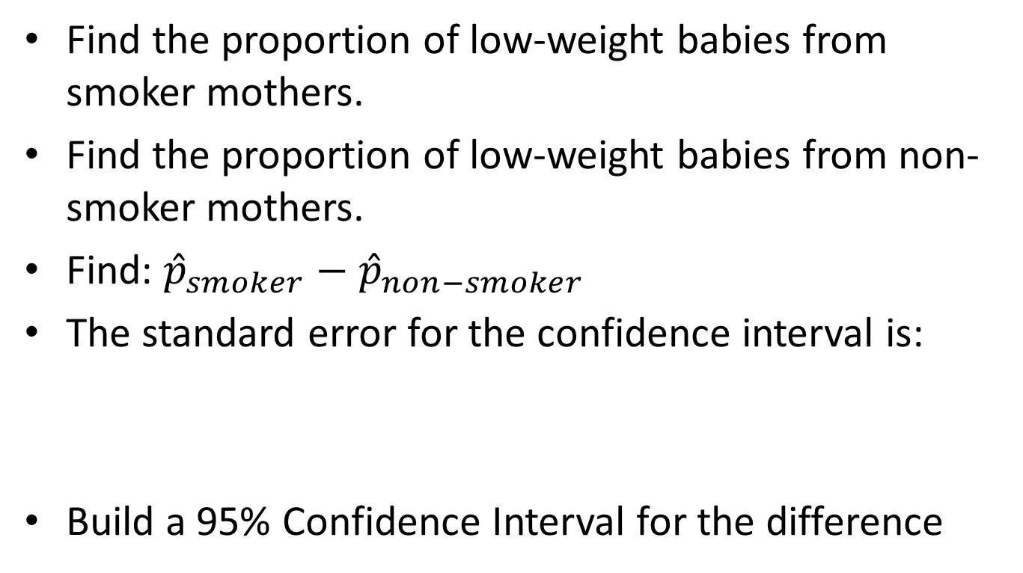
Do smoking mothers give birth to a higher proportion of low-weight babies?
Find the proportion of low-weight babies from smoker mothers.
Find the proportion of low-weight babies from non-smoker mothers.
Find: ${\hat{p}}_{smoker}−{\hat{p}}_{non−smoker}$
The standard error for the confidence interval is:
Build a 95% Confidence Interval for the difference

Slide 5
Do smoking mothers give birth to a higher proportion of low-weight babies?
Now for a hypothesis test:
Null Hypothesis:
Alternative Hypothesis:
Since we are assuming that the two populations are identical we need to build a standard error based on the pooled proportion:
Find the proportion of all babies in the sample (smokers and non-smokers) that had low-weight. Call this ${\hat{p}}_{pooled}$
The standard error for the hypothesis test is:

Slide 6
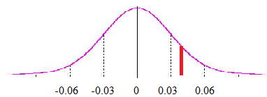
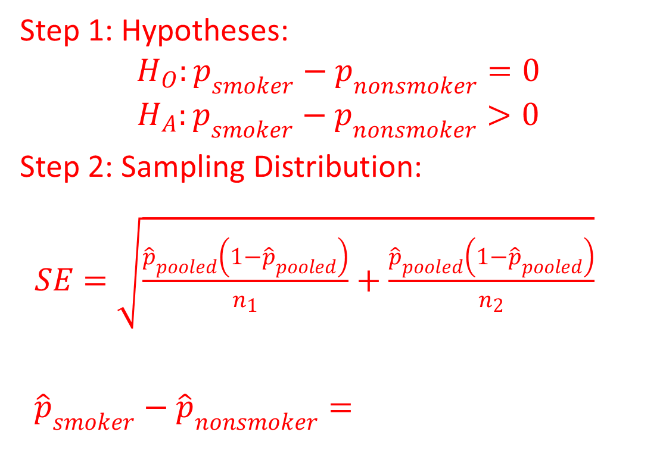
Do smoking mothers give birth to a higher proportion of low-weight babies?
Step 1: Hypotheses:
$$H_{O}:p_{smoker}−p_{nonsmoker}=0$$
$$H_{A}:p_{smoker}−p_{nonsmoker}>0$$
Step 2: Sampling Distribution:
$SE=\sqrt{\frac{{\hat{p}}_{pooled}\left(1−{\hat{p}}_{pooled}\right)}{n_{1}}+\frac{{\hat{p}}_{pooled}\left(1−{\hat{p}}_{pooled}\right)}{n_{2}}}$
${\hat{p}}_{smoker}−{\hat{p}}_{nonsmoker}=$
Things we know:
${\hat{p}}_{smoker}= n_{smoker}=$
${\hat{p}}_{nonsmoker}=$
$n_{nonsmoker}=$
${\hat{p}}_{pooled}=$

Slide 7
Do smoking mothers give birth to a higher proportion of low-weight babies?
Step 3: p-value
p-value =
Step 4: Conclusion:
With a p-value of… we conclude that…

Slide 8
Surprised by the results?
Why is this? Variability in birth weight comes from many factors. While smoking might be one factor, it is not a strong enough factor to see a difference in this data set.
A primary goal of statistics is to find “signals in the noise.” If you don’t find the signal, it could be because it isn’t there, or because there is too much noise. Try limiting other variables.
With the data in this study, we cannot make claims about differences in birth weight…

